Slide 1
Exception handling
Csc 326- alexis figueroa

Slide 2

WHAT is exception handling?
An exception is an abnormal condition that results from the execution of a program (run-time). Some common conditions are
Dividing a number by 0
Accessing an array outside of bounds
Exception handling in the traditional sense are functions such as
exit()
abort()
return values to indicate an error occurred (-1)
Exception handling is based upon 3 major key words
Throw
Catch
Try
if/else statements

Slide 3
Keywords
Throw
CATCH
try
A C++ program uses the word throw to throw an exception. This means that when used as ”throw exception,” it will create a custom error when a problem is detected during run time. When it is used as “throw (a number or a keyword),” the program will execute whatever follows the word throw.
Catch allows you to define a block of code to be executed to handle errors. The program will “catch” an exception at the specific place in a program where a problem has occurred.
Try and catch work together.
Try is what will allow the programmer to test the defined block of code for errors during run time.

Slide 4

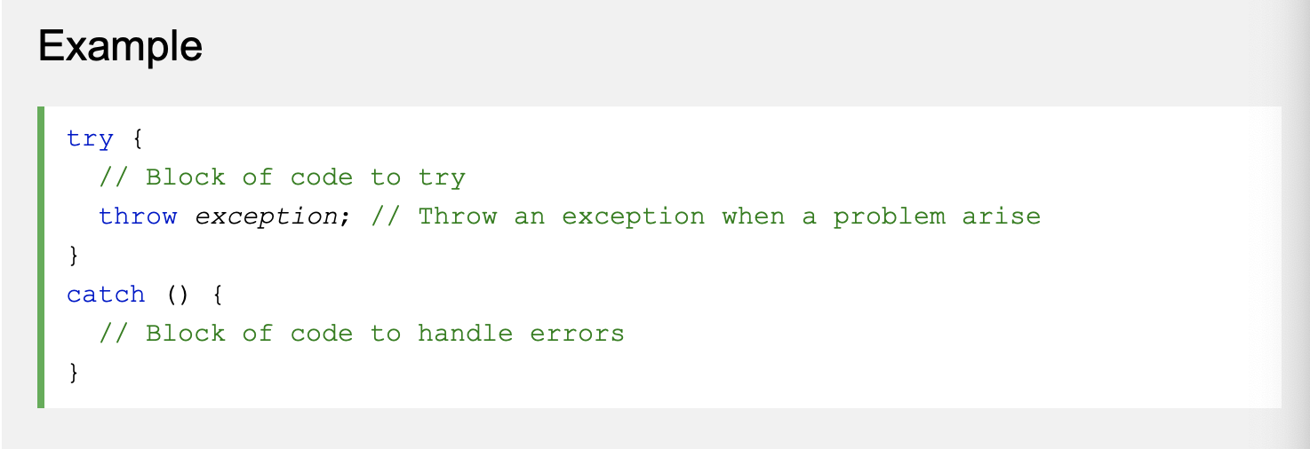
Try and catch method
Example from: https://www.w3schools.com/cpp/cpp_exceptions.asp

Slide 5
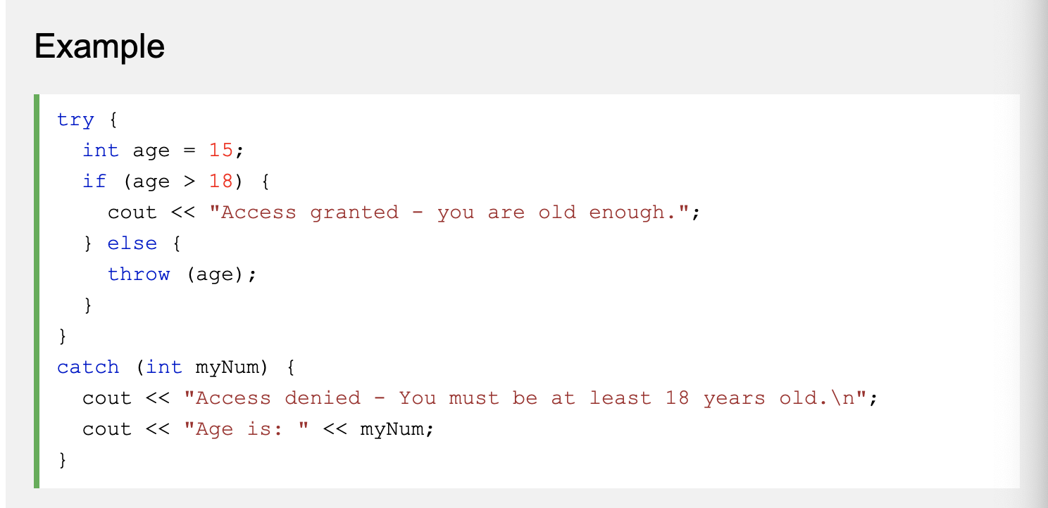
Try, throw and catch used together
Example From: https://www.w3schools.com/cpp/cpp_exceptions.asp

Slide 6
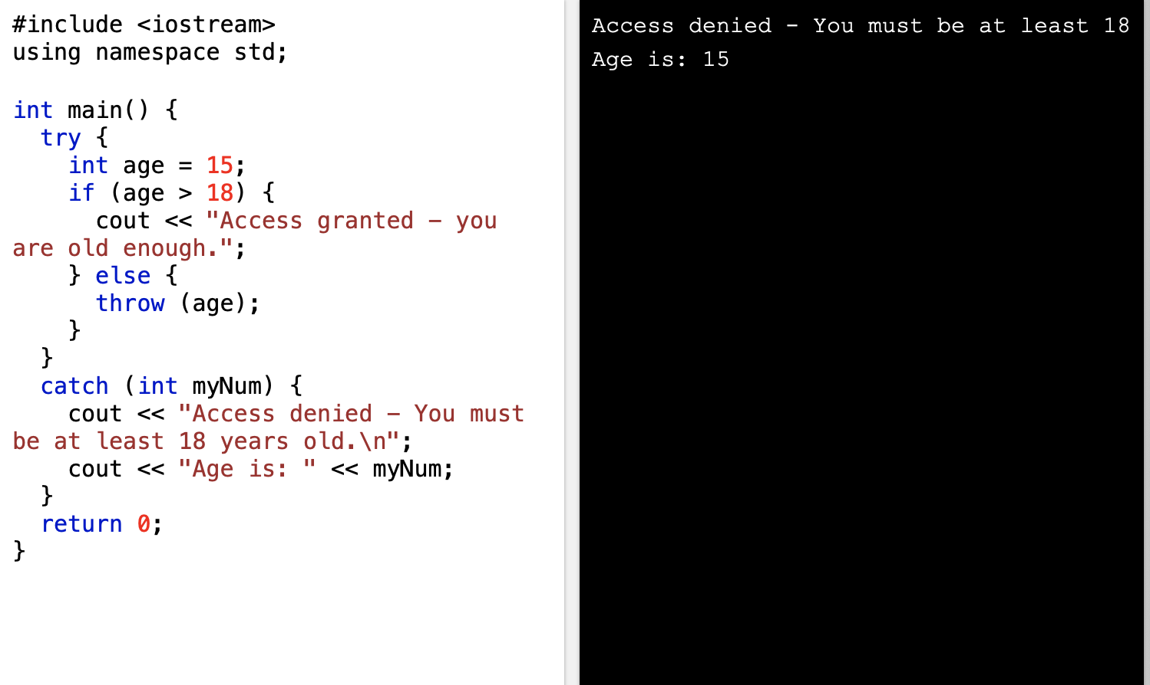
Output to previous example using throw “keyword”
As you can see, the program tried this block of code to test for age. Due to the age being set to 15 which is less than 18, in the try portion, there was an error during run time activating the catch section. In that instance it executed the “throw” exception when it found the error which was throw(age) where age=15.

Slide 7
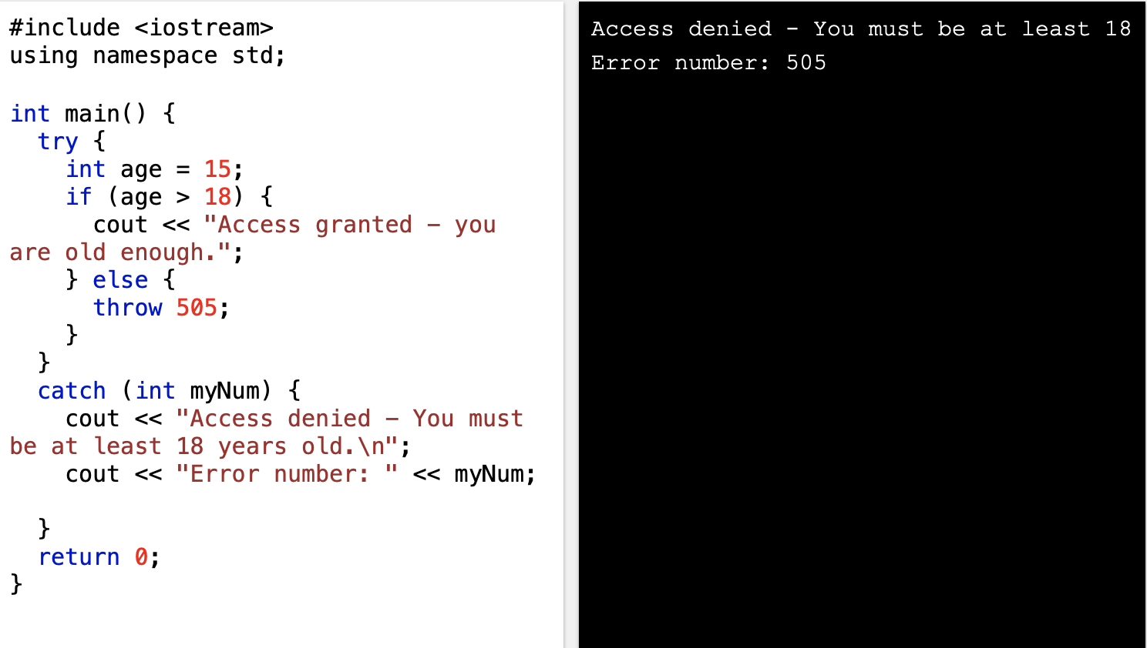
Output from previous example using throw “number”
In this output, instead of “throwing” a keyword such as “age” in the previous example, the code will now throw the number 505 when the error occurs during run time.

Slide 8
Catch block to handle any type of exception
A catch can be created to handle any type of exception thrown from the try block. This is done in the same exact manner as try and catch except for the catch function accepting a different parameter. Instead of catch accepting a specific parameter as shown in the previous example such as, int myNum, it will now be catch(…) which is catch followed by an ellipsis. This allows the code to handle any type of exception thrown during run time.
Info from: https://www.tutorialspoint.com/cplusplus/cpp_exceptions_handling.htm

Slide 9
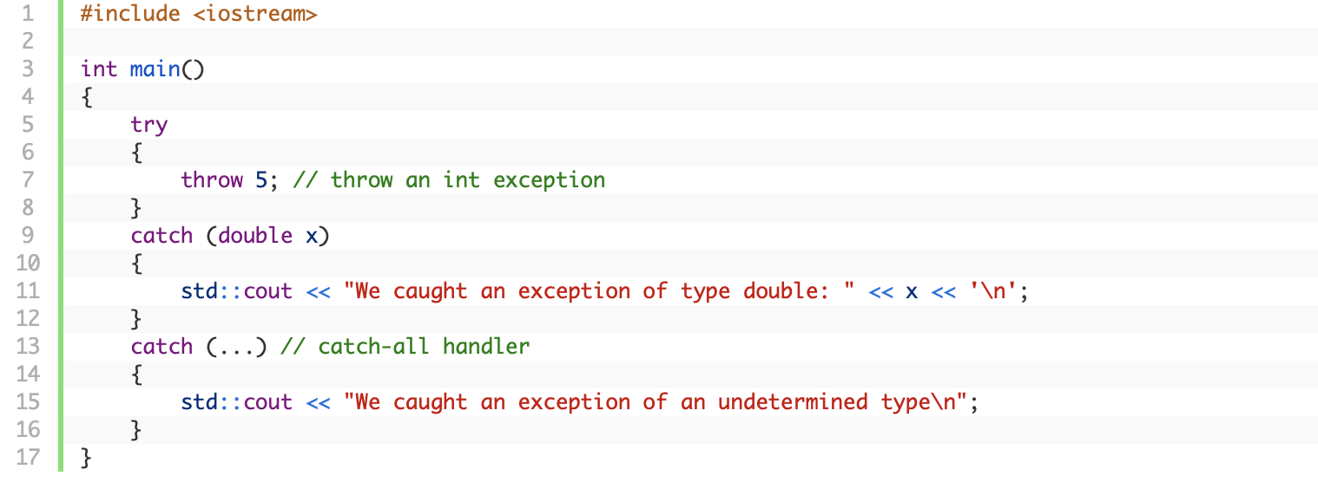
Catch for any exception

